Slide 1

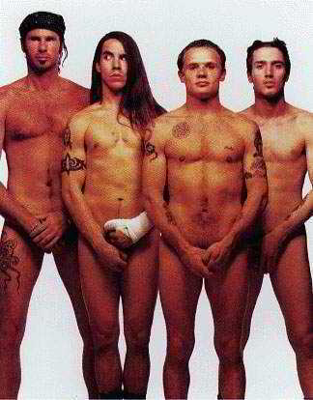
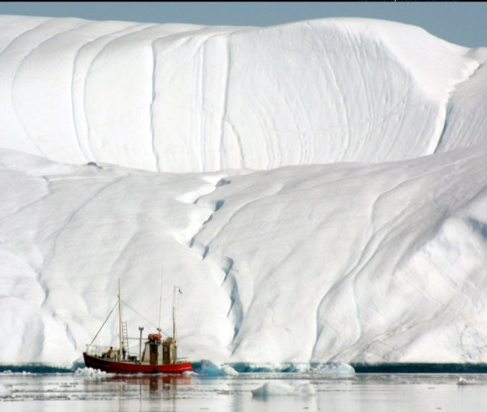
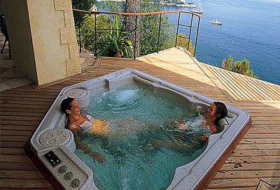
PHYS1001 Physics 1 REGULAR
Module 2 Thermal Physics
IAN COOPER
THERMODYNAMIC SYSTEMS
What do we mean by hot and cold ?
What does temperature measure?
What is the meaning of heat?
PHYSICS: FUN EXCITING SIMPLE

Slide 2
Overview of Thermal Physics Module:
Thermodynamic Systems: Work, Heat, Internal Energy 0th, 1st and 2nd Law of Thermodynamics
Thermal Expansion
Heat Capacity, Latent Heat
Methods of Heat Transfer: Conduction, Convection, Radiation
Ideal Gases, Kinetic Theory Model
Second Law of Thermodynamics Entropy and Disorder
Heat Engines, Refrigerators

Slide 3
THERMODYNAMIC SYSTEMS
* Thermodynamic systems, thermodynamics system (ideal
gas) (§19.1 p646)
* Temperature T, thermometers, temperature scales (K, °C),
Thermal Equilibrium, Zeroth Law of Thermodynamics
(§17.1,2,3 p570 §17.5 p582)
* Conservation of Energy – First Law of Thermodynamics
(§19.4 p651)
* Internal Energy U (§19.6 p658)
* Work W (§19.2 p647)
* Heat Q (§17.5 p582)
* Second Law of Thermodynamics (§20.5 p682)
References: University Physics 12th ed Young & Freedman

Slide 4
Mindmaps – A3 summaries
Equation Mindmaps
Temperature
Energy (work, kinetic, potential,
internal, heat energy,1st law)
Expansion
Heat capacity & latent heat
Heat transfer
Gases, kinetic theory & thermal
processes
2nd Law – entropy
Heat Engines
Carnot Engine
Otto cycle engine
Diesel cycle engine
All equations on Thermal Physics Exam Formula Sheet
Symbols – interpretation, units, signs
Visualization & interpretation
Assumptions
Special constants
Graphical interpretation
Applications, Comments
Numerical Examples

Slide 5
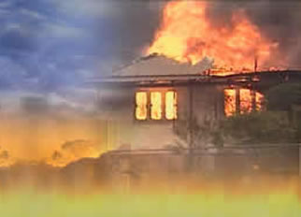
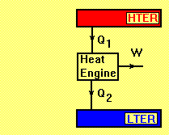

TEMPERATURE – determines direction of heat transfer
Conduction
Convection
Radiation
Temperature scales (Celsius °C and Kelvin K)
Celsius scale: 0 °C (melting water) 100 °C (boiling water)
T_{K} = T_{C} + 273.15
Kelvin scale: Absolute zero 0 K
minimum total energy (KE + PE) of molecules
HOT and COLD
Avg. random KE(tanslation)
Monatomic gas K_{avg} = (3/2)kT
2nd Law – entropy
ΔS = ∫(dQ/T)
Carnot engine:
e = 1 – T_{C} / T_{H}
Expansion: ΔL = α L_{o} ΔT
Heat Capacity: ΔT = Q / m c
Q = n C ΔT
Since a thermometer measures its own temperature it must come into thermal equilibrium with a system before its temperature can be measured
Ideal Gases:
pV = n R T = N k T
ΔU = n C_{V} ΔT
Thermal processes
Isothermal: p V = const.
Adiabatic: T V^{γ-1}= constant
CALORIMETRY calculations – conservation of energy

Slide 6
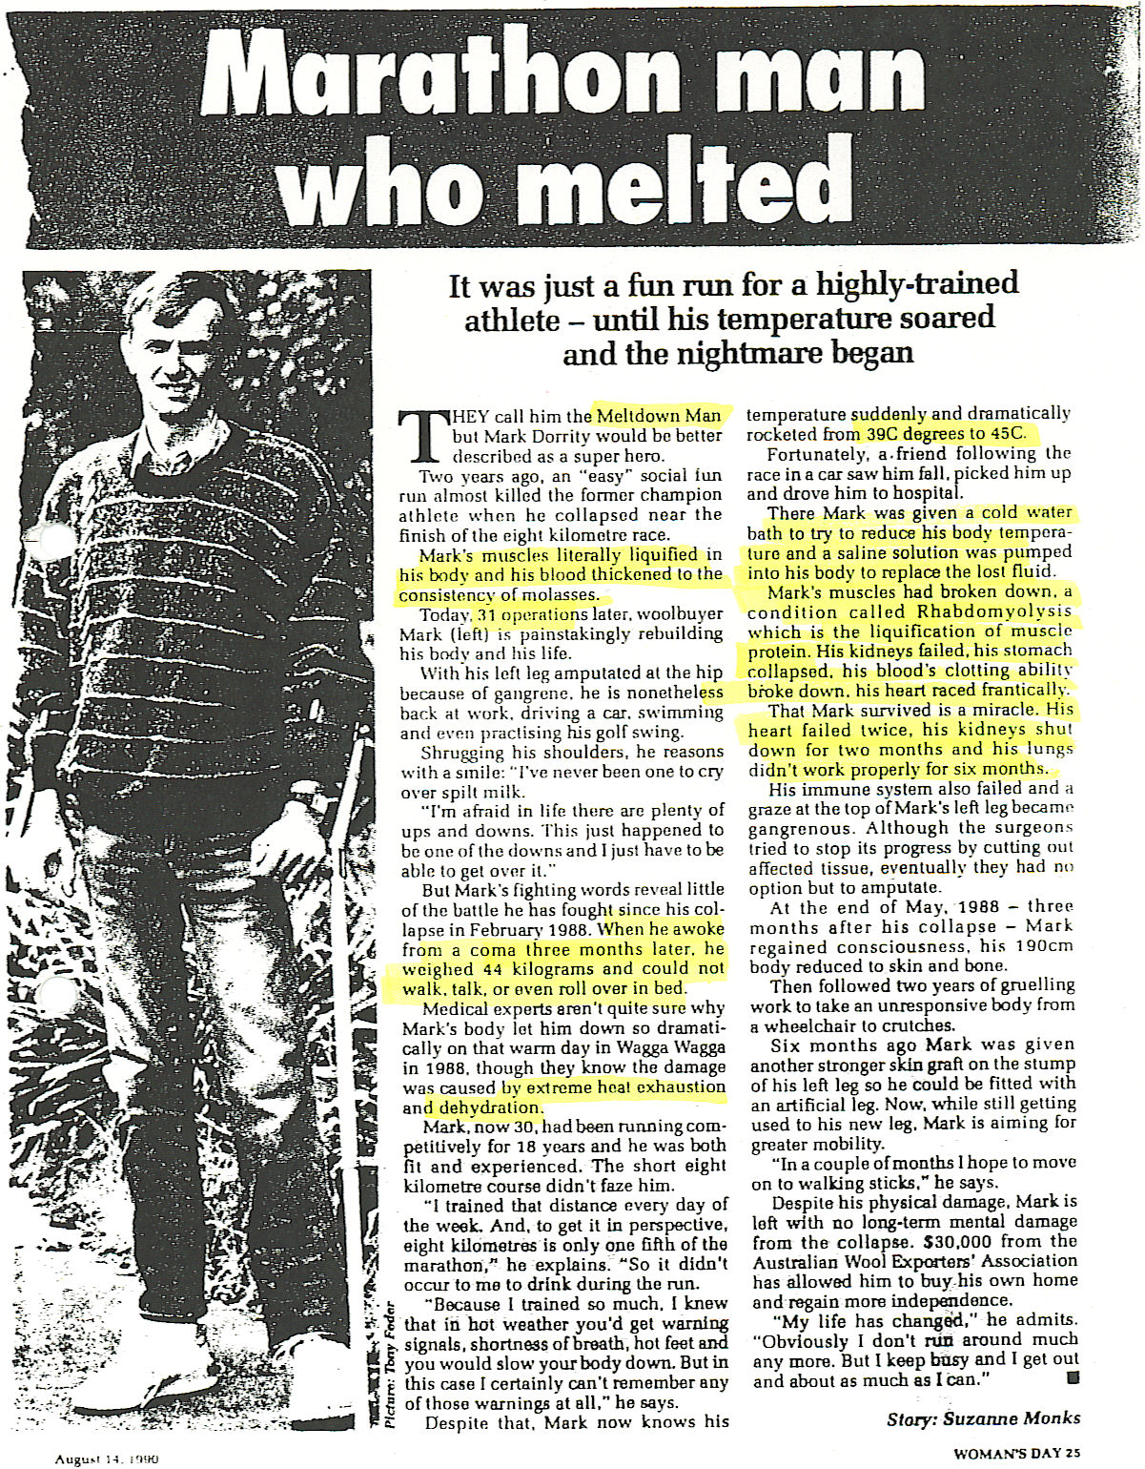
Basal metabolic rate ~ 75 W
Prolonged hard labour internal heat production ~ 700 W
Hot day: solar energy input ~ 150 W

Slide 7
MARATHON MAN WHO MELTED
Meltdown Man Feb 1988
“It was just a fun run for a highly trained-trained athlete – until his temperature soared and the nightmare began” Woman’s Day Aug 14, 1990
EXTREME HEAT EXHAUSTION & DEHYDRATION
Core temperature 39 °C to 45 °C
Mark’s muscles literally liquefied (rhabdomyolysis – liquification muscle protein), blood thickened like molasses and failed to clot, kidneys failed, stomach collapsed, heart raced, lung problems, immune system failed - left leg amputated at hip (gangrene), coma (3 mths), mass 44 kg, could not walk, talk or roll over
31 operations

Slide 8
Body temperature
> 40.6 ºC ⇒ cell growth stops
> 42 ºC ⇒ irreversible chemical damage to the brain,
kidneys, and other vital organs
> 46 ºC ⇒ liquifications of proteins
T_{env} > 34 ºC ⇒ evaporation of perspiration only effective
mechanism for cooling the body
max rate of cooling ~ 650 W

Slide 9
THERMODYNAMIC SYSTEM
single or collection of objects
macroscopic & microscopic views
Environment
or surroundings
System boundary
SYSTEM
Thermodynamic process: changes in p,V,T, U, S… by heat Q added or removed and/or work done W on or by the system
Quantity: mass m, moles n
# molecules, N
Dimensions: length L, area A, volume V
Pressure P
Temperature T
Internal Energy U
Entropy S
HEAT Q
WORK W

Slide 10
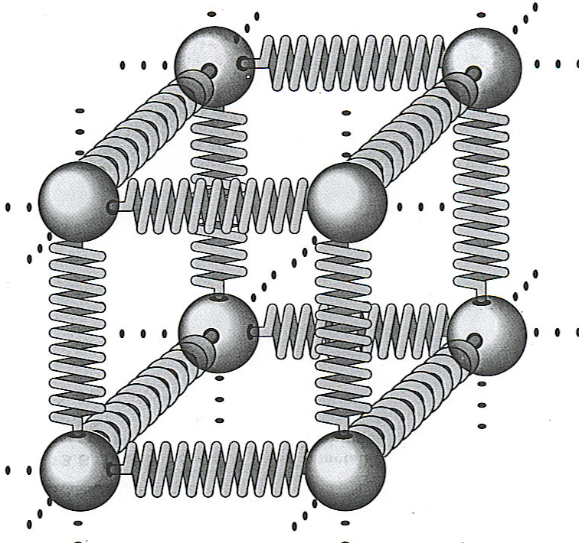
 INTERNAL ENERGY U [J joule]
Value of U not important, ΔU during a thermal process is what matters:
interaction
between atoms
& molecules
Random chaotic
motion
Kinetic energy: translation, vibration, rotation
Thermal Energy = Internal Energy
Thermal Energy = very broad term, no specific meaning

Slide 11
The internal energy U of an ideal gas depends only on its temperature, not on its pressure or volume
U= U(T)
The internal energy of an isolated system is constant.
Internal energy is not a form of energy but a way of describing the fact that the energy in atoms is both stored as potential and kinetic energy. Does not include KE of the object as a whole or any external PE due to actions of external forces or relativistic energy (E=mc²).

Slide 12
INTERNAL ENERGY - it is composed of the following types of energies:
Sensible energy - internal energy associated with random, chaotic kinetic energies (molecular translation, rotation, and vibration; electron translation and spin; and nuclear spin) of the molecules.
Latent energy - the internal energy associated with the phase of a system.
Chemical energy - the internal energy associated with the atomic bonds in a molecule.
Nuclear energy the very large amount of energy associated with the strong bonds within the nucleus of the atom itself.

Slide 13
 WORK W [ J]
A
F
A
F
force F by gas on cylinder (expansion)
F = p A
force F applied on gas (compression)
Work done = area under a p-V curve
W > 0 energy removed from system by system doing work on the surroundings (expansion)
W < 0 energy added to system by work being done on the system by its surroundings (compression)
What constitutes an equation mindmap for work?

Slide 14
F = p A
dx
p
W
A
1, 2
p
V
Cyclic:
clockwise 1 to 2 W > 0
anticlockwise 1 to 2 W < 0
1
2
1
p
V
2
W > 0
V
2
p
1
p
W < 0
1
2
W = p ΔV > 0
V
V
Work done = area under a p-V curve

Slide 15
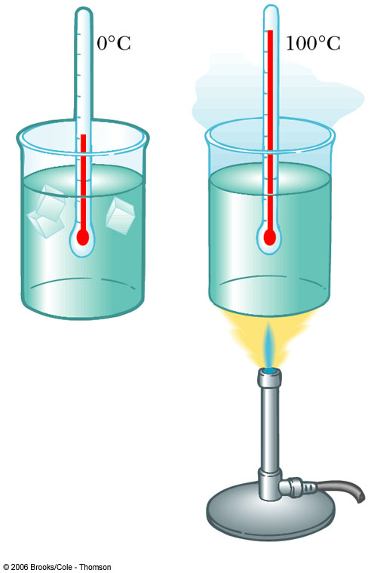
What is heat Q?
What is temperature T ?
0 ºC
100 ºC
red hot chili pepper
Heating water – what does the picture tell you?

Slide 16
 SECOND LAW OF THERMODYNAMICS
system will spontaneously evolve to an equilibrium state (state with highest probability)
T₁
T₂
T₁ > T_{E}
time
T₂ = ?
T_{environment} = T_{E}

Slide 17
 HEAT Q – energy transfer due to a temperature difference
T_{environment} ≡ T_{E}
Q = 0
T₁ > T_{E}
T₁ < T_{E}
Heat Q_{net} < 0
Heat Q_{net} > 0
T₂ = T_{E}
T₂
Thermal Equilibrium
 0th Law of Thermodynamics
T₁
T₁
Two systems are in thermal equilibrium if - and only if - they are at the same temperature
Spontaneous transfer of energy
1
2
 Temperature difference determines the direction of heat transfer

Slide 18
 1st LAW OF THERMODYNAMICS
Conservation of energy – transfer of energy by work W and heat Q between a thermodynamic system and its surrounding environment gives a change in internal energy:
ΔU = Q – W
Paths between thermodynamic states
Q and W depend upon the path taken between two states.
ΔU depends only on the initial and final states, i.e. ΔU is independent of the path and does not depend upon the kind of process that occurs (experimentally proven).
⇒ U is an intrinsic property of a system.
It is meaningful to speak of the internal energy of a system, but not how much heat it contains.

Slide 19
First Law of Thermodynamics
W
W > 0 work done by system
on surroundings
W < 0 work done on system
Q > 0 heat added to system
Q < 0 heat removed from
system
Q

Slide 20
TEMPERATURE T – measure of the average random, chaotic translational motion of the particles of the system
total translation KE of gas molecules K_{tr}
T
T + ΔT
K_{tr} + ΔK_{tr}
n moles ideal gas

Slide 21
TEMPERATURE measurement
Thermometers:
Change in dimensions – liquid thermometer
Pressure change – gas thermometer
Electromotive force – Thermocouple
Electrical resistance – Thermistor
Buoyancy – Galilean thermometer
Electromagnetic radiation – Pyrometer, artery thermometer
Since a thermometer measures its own temperature, it must come into thermal equilibrium with a system before its temperature can be measured.

Slide 22
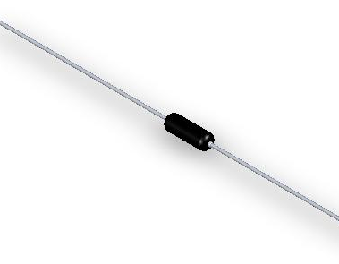
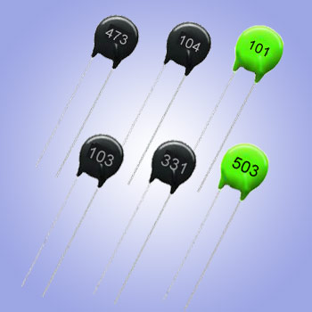
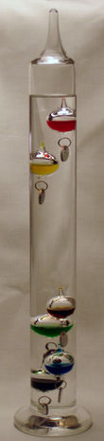
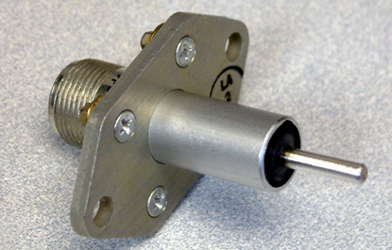
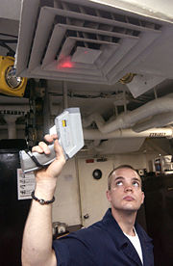
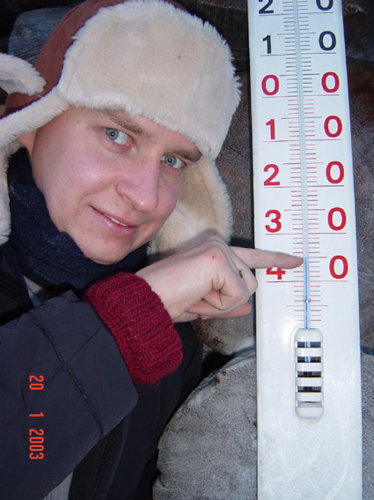
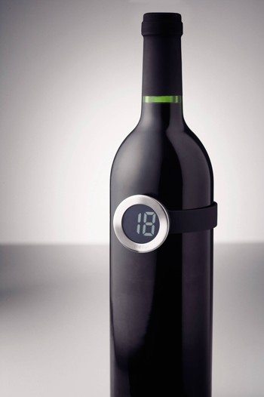
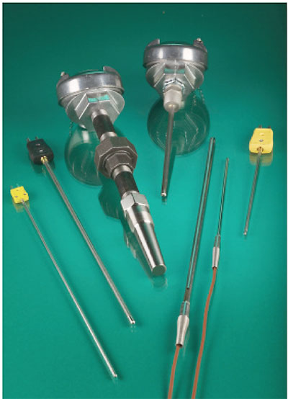
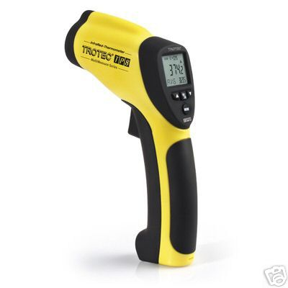
Thermometers
Thermistor
Galilean
thermometer
Pyrometer
Thermocouple

Slide 23
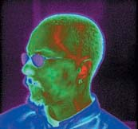
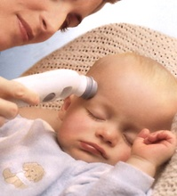
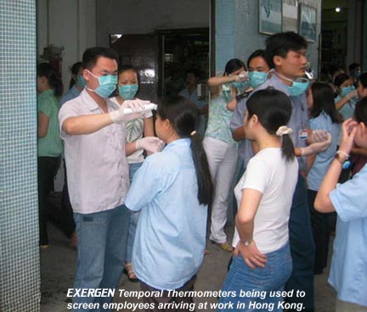
Temporal artery thermometer – measuring infrared emission
Infrared scan

Slide 24
Is the human skin a thermometer ?
Can you tell the temperature of an object by touching it?
Is the chair hot or cold?

Slide 25
Is the human skin a thermometer?
Human skin is not a thermometer because it does not come into thermal equilibrium with the object it is touching.
Our bodies core temperature will stay at 37 °C. The nerves in the skin measure rates of heat transfer and are intended to give a warning of uncomfortable low or high temperatures.
On a hot sunny day, a metal and a wooden block were placed on the ground in the open. The metal conductor will feel hotter to a person touching it than the wood (a poor conductor) even though the metal and wood are at the at the same temperature.

Slide 26
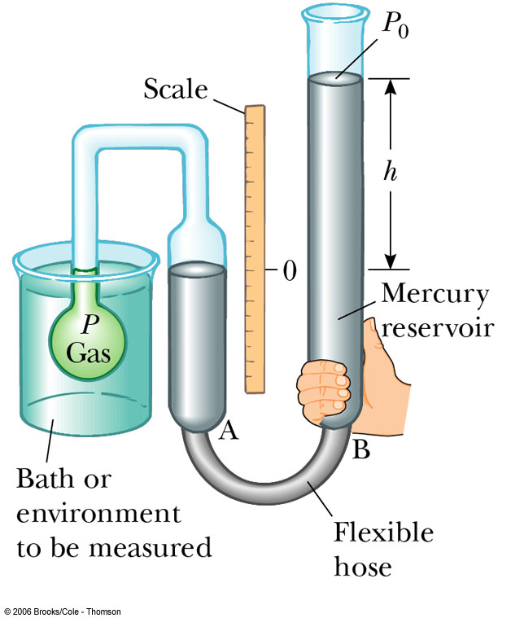
Temperature scales (Kelvin K & Celsius °C)
T K = T °C + 273.15
Kelvin scale
Absolute zero 0 K
min total energy (KE + PE) of system
Constant volume gas thermometer
p = constant x T (T in K)

Slide 27
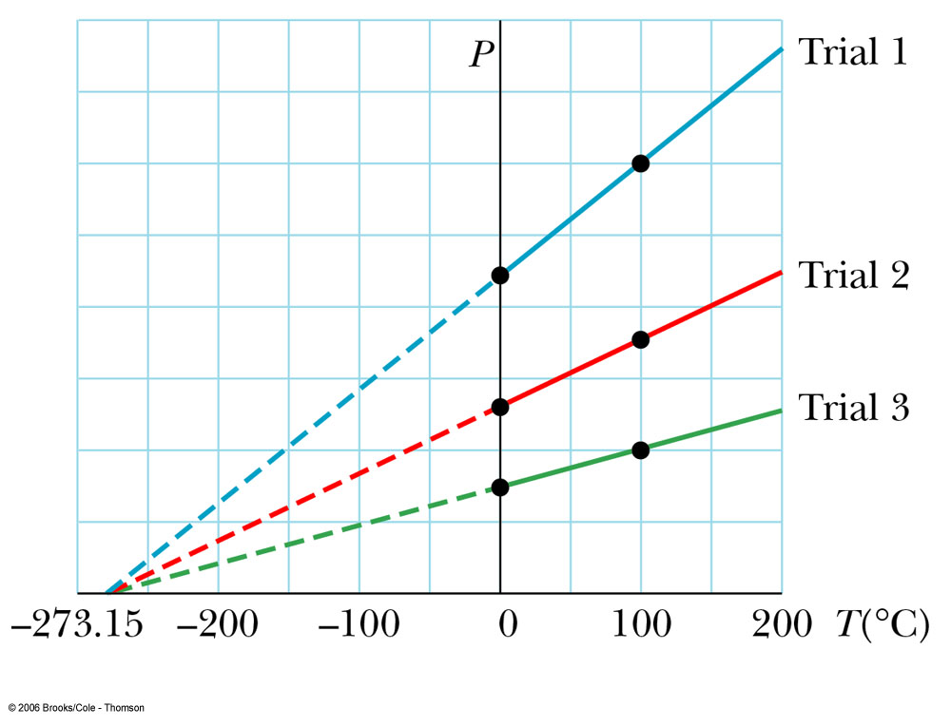
Gas Thermometer
If temperature measurements are performed with gas in flask at different starting pressures at 0°C, the data looks like the graph.
In each case, regardless of the gas used, the curves extrapolate to the same temperature (absolute zero) at zero pressure.
Gases liquefy and solidify at very low temperatures, so we can’t actually observe this zero-pressure condition.
The absolute-zero reference point forms basis of Kelvin temperature scale

Slide 28
Absolute zero 0 K (-273.15 °C)
Helium boils 4 K (-269 °C)
Nitrogen boils 77 K (-196 °C)
Oxygen boils 90 K (-183 °C)
Dry ice (CO²) freezes 194 K (-79 °C)
Water freezes 273 K (0 °C)
Room temperature ~293 K (~20 °C)
Body temperature 310 K (~37 °C)
Water boils 373 K (100 °C)
Copper melts 1356 K (1083 °C)
Bunsen burner 2103 K (1870 °C)
Surface of the sun ~6000 K
Iron welding arc ~6020 K

Slide 29
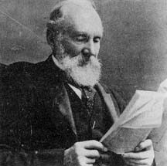
Lord Kelvin
William Thompson
born Belfast 1824
Student in Natural philosophy
Professor at 22!
Baron Kelvin of Largs in 1897
A giant - Thermodynamics, Foams, Age of the Earth, Patents galore

Slide 30
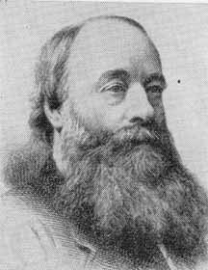
Sir James Joule
James Joule 1818-1889
Stirring water made it warm
Change in temperature proportional to work done
Showing equivalence of heat and energy
Also that electrical current flow through a resistor gives heating

Slide 31
Identify ⇔ Setup ⇔ Execute ⇔ Evaluate
IDENTIFY
Identify what the question asking
Identify the known and unknown physical quantities (units)
SETUP need a good knowledge base (memory + understanding)
Visualise the physical situation
Diagrams - reference frames / coordination system / origin / directions
Write down key concepts, principles, equations, assumptions that may be
needed to answer the question
EXECUTE
Answer to the question from what you know.
Numerical questions - solve before calculations - manipulate equations
then substitute numbers add comments.
EVALUATE
CHECK - answer reasonable, assumptions, units, signs, significant
figures, look at limiting cases

Slide 32
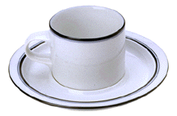
Typical exam question
Consider a hot cup of coffee sitting on a table as the system. Using this system as an illustration, give a scientific interpretation of the terms: temperature, heat, work, internal energy, thermal equilibrium.

Slide 33
Identify / Setup
temperature T (K)
heat Q (J)
work W (J)
internal energy U (J)
thermal equilibrium
0th law 1st law 2nd law
T_{H}
Q
T_{C}
surroundings

Slide 34
2. Execute
(i) Temperature T – measure of hot/cold as determined by a temperature scale
T_{H}
Q
hot cold
T_{H}
>
T_{C}
Q
(ii) Heat Q energy transferred spontaneously due to a temperature difference (hot to cold) 2nd Law
T_{C}
(iii) Work W
Change in volume of coffee is negligible ⇒ W = 0

Slide 35
(iv) Internal Energy U
interaction
between atoms
& molecules
Random chaotic
motion
1st Law: Conservation of energy – transfer of energy by work W and heat Q between thermodynamic system and surrounding environment gives a change in internal energy ΔU = Q – W
Heat is transferred to surroundings from the coffee, giving a decrease in the coffee’s internal energy: W = 0, Q < 0 ⇒ ΔU < 0 (decrease in temperature)
(v) The temperature of the coffee decreases until it is in thermal equilibrium with the surroundings
T_{coffee} = T_{surroundings} 0th Law

Slide 36
Evaluate
Have you answered the question – given an explanation in terms of scientific principles and terminology and not simply given a description?
hot cold

